Slide 1
Credit Card Fraud Prediction
DSC630 Course Project: Milestone 4 - Data Selection and Project Proposal Ganeshkumar Muthusamy, Vasanthakumar Kalaikkovan & Venkata Kanaparthi

Slide 2
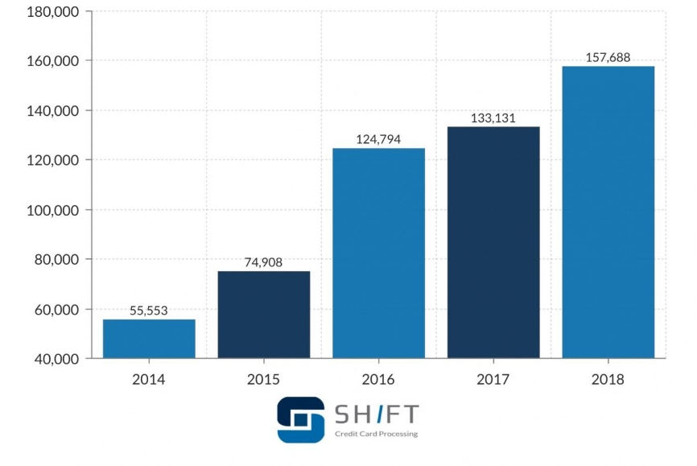

Background of the problem
In the year 2018, a total of $24.26 Billion was lost due to payment card fraud across the globe, and United States is the most fraud-prone country.
Financial institutions like Visa, MasterCard, Discover, and all debit networks have mandated that banks and merchants introduce EMV card technology to counter the fraud.
There can be two kinds of card fraud, card-present fraud, and card-not-present fraud. Card, not present fraud is almost 81 percent more likely than point-of-sale fraud.

Slide 3
Proposal
Using Machine learning algorithms, we will predict if credit card transaction is fraudulent or non-fraudulent.
Train the data with 75% of the dataset and test with the remaining 25% of the dataset.
Build a couple of classification models and evaluate their performance then select the best model.
Process Overview
Preliminary analysis on data
Data preparation and cleaning
Exploratory Data Analysis
Train and test models
Model evaluation and tuning

Slide 4
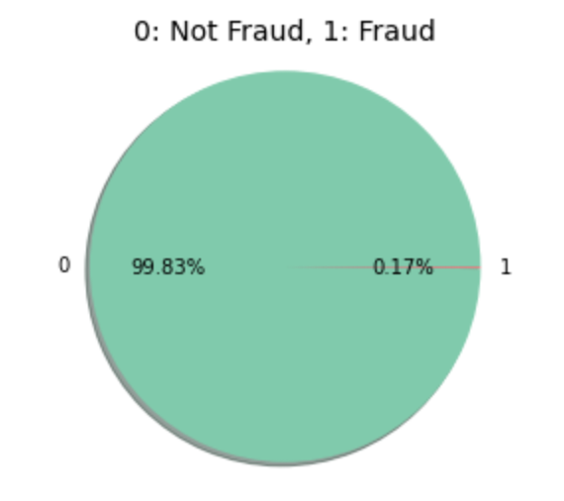
Data Understanding
The dataset that is selected has transactions from European cardholders made in 2013.
It has 285,000 transactions out of which 492 are fraudulent.
The dataset is highly unbalanced, the positive class (frauds) account for 0.172% of all transactions. Data is PCA transformed.

Slide 5
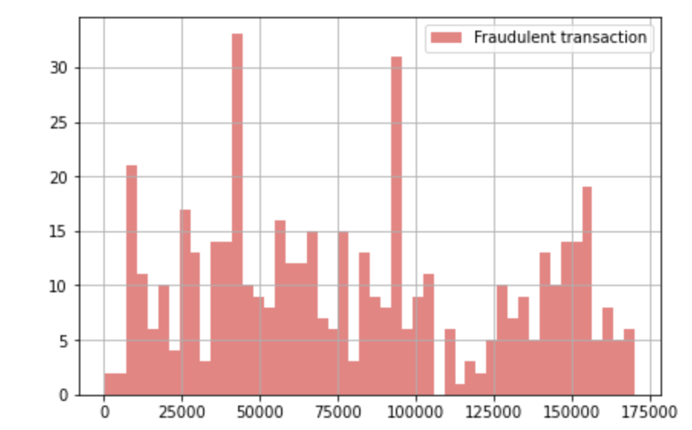
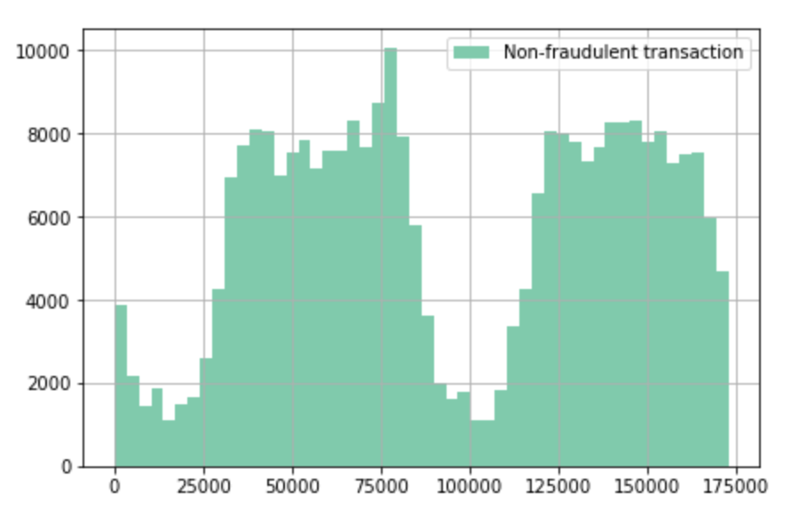
Transaction Times
There is no set time frame in a day when Fraudulent transactions occur. They are spread throughout the day.
This makes Transaction time, not one of the important features we can use for our model to determine if a particular transaction is fraudulent or not.

Slide 6
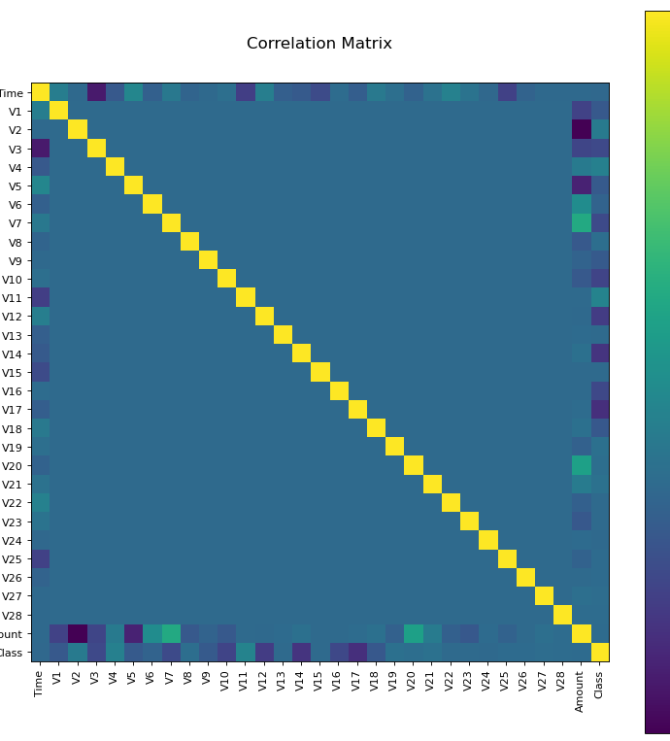
Exploratory Data Analysis
The matrix is used to find the correlation between all the possible pairs of values in the dataset.
In this matrix, time is negatively correlating with all the variables.
Similarly, amount is also negatively correlating will all other variables.
Finally, there is no variable which is positively correlating with any variables.

Slide 7
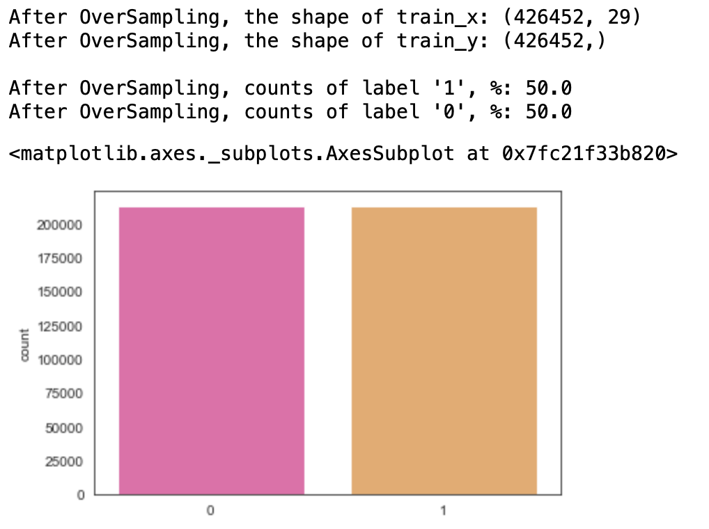
SMOTE – Oversampling
By SMOTE, we are not losing any information from the original training set as all the observations from the minority and majority classes are retained.
SMOTE works by utilizing a k-nearest neighbor algorithm to create synthetic data.
We are choosing this technic because the dataset is highly imbalanced.
There are many non-fraudulent transactions compared to fraudulent transactions.

Slide 8
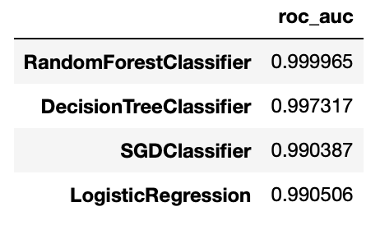
Classification models
Using the training data set, an aggregate measure of performance across the 4 classification models which we created.
Based on the accuracy scores, we have finalized to use RandomForest and Logistic Regression model.
The hyper parameters are tuned for the model using Gridsearch to evaluate the performance.

Slide 9
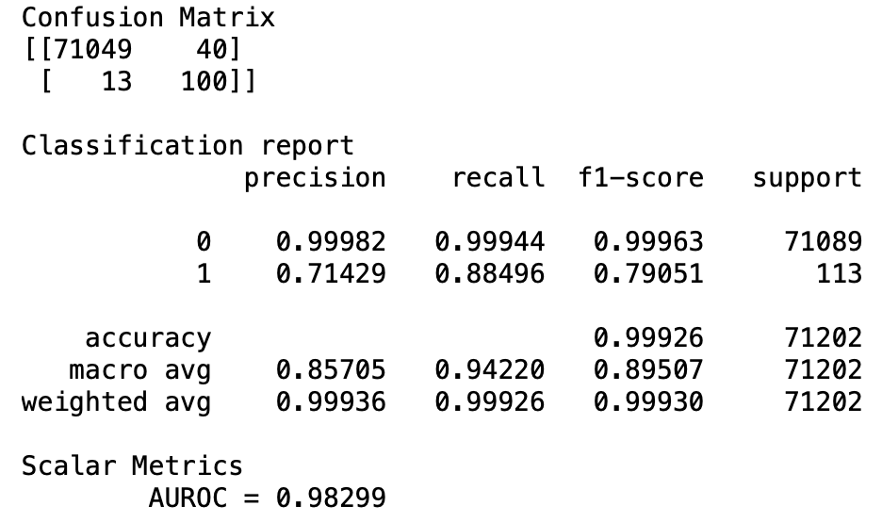
Random Forest models
Based on a high roc_auc value, Random Forest Model provides us high true prediction values for our dataset.
This model has an AUROC of 0.98299 which means that the model has a very good discriminatory ability.
98.30% of the time, our model will correctly predict if the transaction was fraudulent or not.

Slide 10
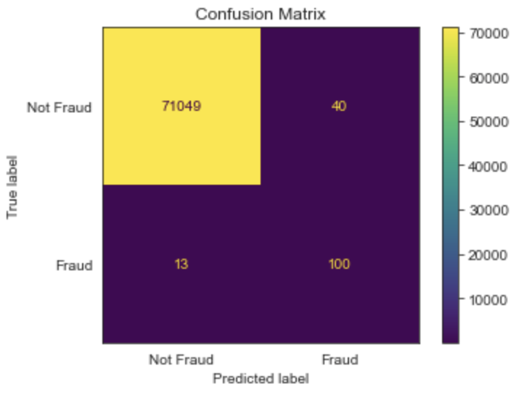
Random Forest models – Confusion Matrix
71049 cases are true negative, meaning they are non-fraudulent transactions and the model predicted them as non-fraudulent.
100 transactions are truly positive, meaning they were predicted as fraudulent and are actually fraudulent ones.
13 instances are false negative and 40 are false positives.

Slide 11
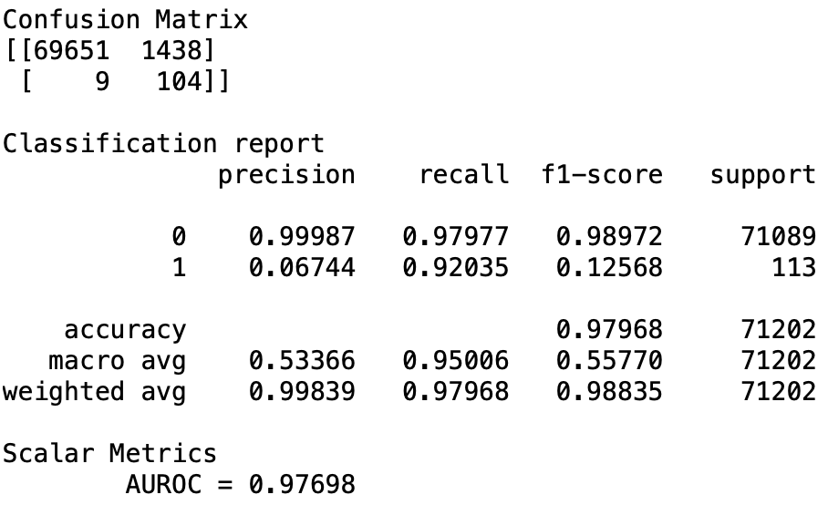
Logistic Regression models
Based on a high roc_auc value, logistic regression Model provides us high true prediction values for our dataset.
This model has an AUROC of 0.97698 which means that the model has a very good discriminatory ability.
97.7% of the time, our model will correctly predict if the transaction was fraudulent or not.

Slide 12
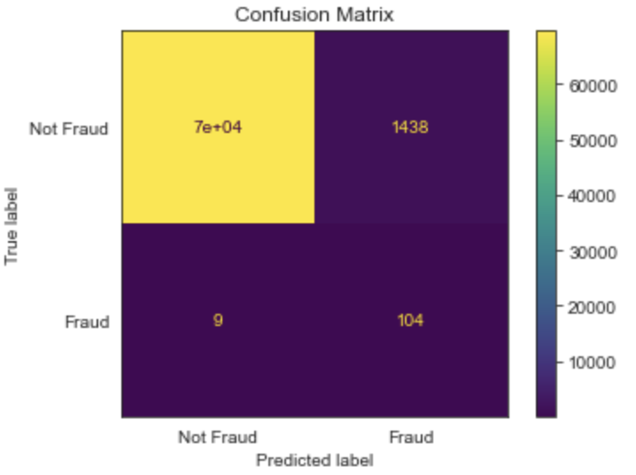
Logistic Regression models – Confusion Matrix
7e+04 cases are true negative, meaning they are non-fraudulent transactions and the model predicted them as non-fraudulent.
104 transactions are truly positive, meaning they were predicted as fraudulent and are actually fraudulent ones.
9 instances are false negative and 40 are false positives.

Slide 13
Conclusion
Transaction time does not have any influence on the prediction of fraudulent transactions.
This was proven by SelectKBest. SMOTE oversampling technique helped overcome the Imbalanced datasets challenge.
Based on a comparison of the confusion matrix of classification models, we recommend that Random Forest classification would be a better performing model to predict whether a transaction is fraudulent or not.
The random forest model has fewer false positives than logistic regression.

Slide 14
Reference
https://www.kaggle.com/mlg-ulb/creditcardfraud
https://www.self.inc/info/credit-card-fraud-statistics/
https://shiftprocessing.com/credit-card-fraud-statistics/

